Slide 1
Question Matching using BERT
Ronak Sankaranarayanan, Siddhi Patil, Sitanshu Rupani

Slide 2
Question Matching
What is Question Matching?
Identification of similar questions is known as Question Matching
Need for Question Matching
Match answers to different sounding questions
Beneficial to users with high quality human-generated answers for solving their problems

Slide 3
The Dataset
Dataset taken from Kaggle
https://www.kaggle.com/c/quora-question-pairs/data
404,290 question pairs in the dataset
Variable Name | Description
qid1 | Question ID 1
qid2 | Question ID 2
question1 | Full text of Question 1
question2 | Full text of Question 2
is_duplicate | Ground truth, indicator if both questions are similar

Slide 4
Dataset & Pre-Processing
Around 37% duplicate questions in dataset
Random Sample of 40000 question pairs
Remove rows with empty question texts
Replaced contractions such as ‘what’s’ with ‘what is’, ‘can’t’ with ‘can not’, etc.
Removed special characters
Split Dataset into Train, Validation & Test Sets (80-20-20)

Slide 5
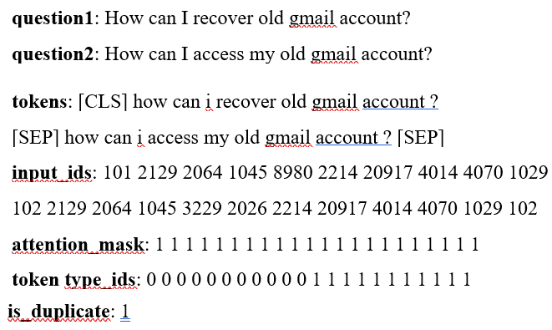
Pre-Processing Steps
Split into tokens
Add [CLS] & [SEP] tokens
Map tokens to IDs
Apply Padding
Create Attention Mask and Token Type Ids

Slide 6
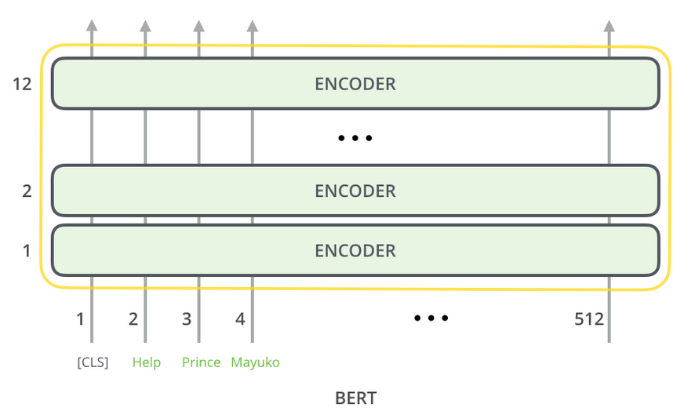
BERT
Bidirectional Encoder Representations from Transformers (BERT) released and pre-trained by Google for NLP tasks in late 2018
12 Transformer Encoding layers or 24 for large BERT
Pre-trained using plain text corpus
Takes a sequence of words as input
Each layer applies self-attention and passes results through a feed-forward network to the next encoder

Slide 7
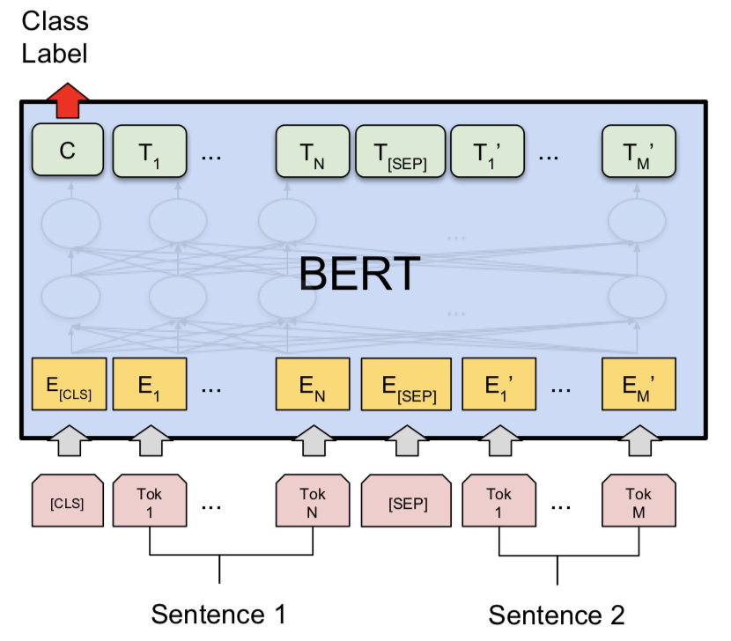
BERT Model
Used Bert-Base-Uncased model :
12 layers, 12 attention heads, 110 million parameters
Fine-tuned for the classification task :
Added softmax last layer on top of the BERT model to classify duplicate questions
With input data, the pre-trained BERT model and the additional untrained classification layer is trained using gradient descent

Slide 8
Hyper parameter Tuning
Number of layers
Activation functions
Number of units
Drop out rate
Number of attention heads
Learning rate
Epochs

Slide 9
Results
Model | Validation accuracy | Testing accuracy | Precision | Recall | F1 score
Relu activation | 72 | 71 | 0.75 | 0.76 | 0.71
Gelu activation | 73.60 | 73.90 | 0.76 | 0.77 | 0.74
7 Layers | 79% | 77% | 0.77 | 0.78 | 0.77
12 Layers | 80% | 80.8% | 0.8 | 0.82 | 0.8
24 Attention heads | 78.9% | 78.25% | 0.77 | 0.78 | 0.77

Slide 10

Demo

Slide 11
Thank You

